Slide 1


Mapping Change in Large
Networks
Capstone Project Phase 1
25-1-R-13
Students:
Yossi Shem Tov | Shimron Ifrah
Supervisors:
Dr. Renata Avros
Prof. Zeev Volkovich
1

Slide 2
Table of contents
01
02
03
04
05
06
Problem Definition
Project Aim
Workflow
Insights and Applications
UML
Testing Plan
2

Slide 3
Problem Definition
Citation networks, which represent the evolution of research through
citations , are vast and continuously evolving.
Challenges in Analyzing Large Citation Networks:
Complexity: Networks are large and dynamic, which makes detecting meaningful trends challenging.
Noise: Citation patterns include irrelevant data, making it hard to see significant trends and insights.
Interpretability: Existing methods often struggle to provide clear and useful information for researchers.
3

Slide 4

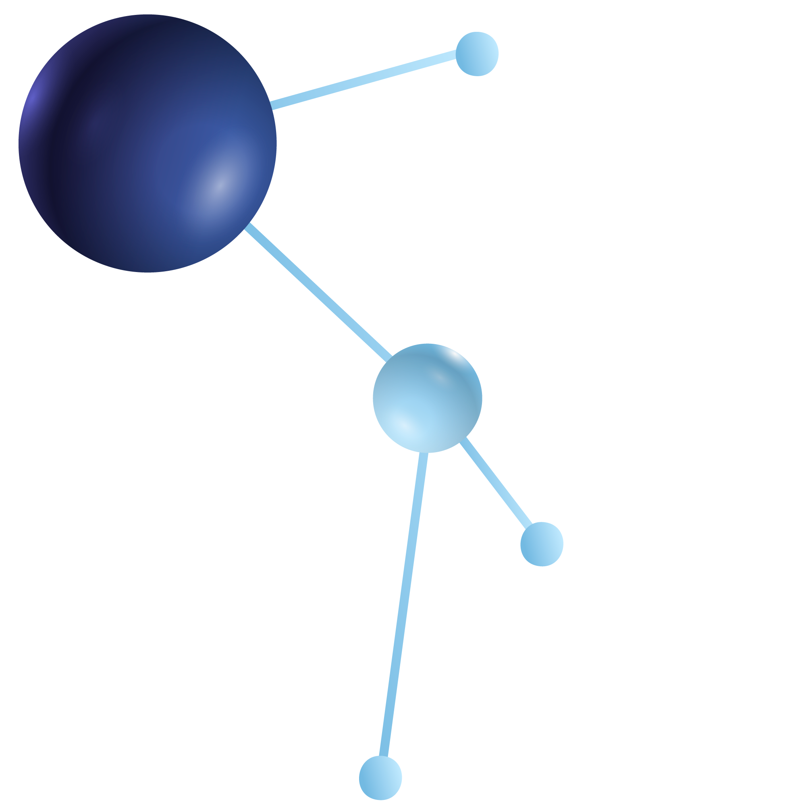
Project Aim
Objective:
Develop a framework to analyze and visualize structural changes in
citation networks.
How This Solves the Problem:
Detects research trends – Identifies which fields are growing, stable, or declining over time.
Filters out noise – Removes irrelevant citations to highlight important patterns.
Improves interpretability – Provides clear and useful visualizations to help researchers.
4

Slide 5
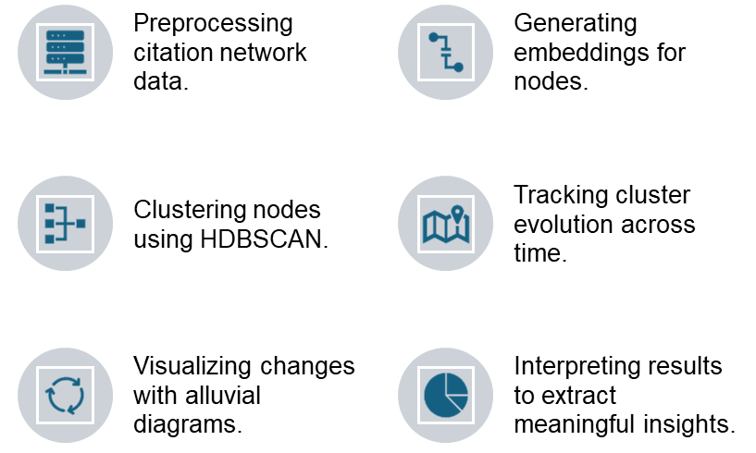

Workflow
Overview
5

Slide 6
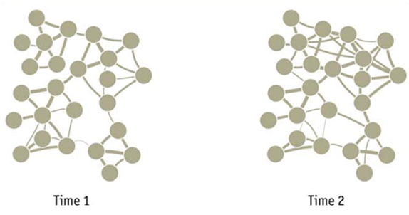

Workflow
Preprocessing
Objective: Prepare and clean citation network data for analysis.
Steps:
Collect citation data over multiple time points.
Represent networks as directed, weighted graphs, where:
Nodes -research papers.
Edges - citations between papers.
6

Slide 7
Workflow
Embedding Generation
Objective: Create numerical vector representations of network nodes.
Algorithms
GraphSAGE++ – Creates node embeddings by sampling and aggregating features from neighboring nodes.
FastGCN – Processes large graphs efficiently using
layer-wise sampling , while preserving structural information.
Outcome: Compact and meaningful node embeddings for clustering and analysis.
7

Slide 8
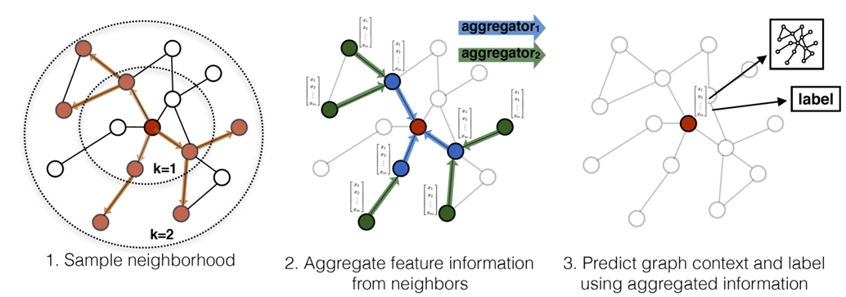
GraphSAGE++
8

Slide 9
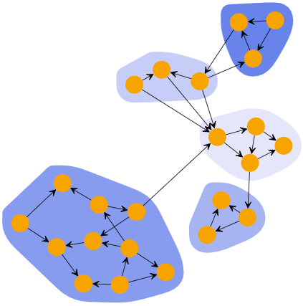
Workflow
Clustering
Objective: Group similar nodes into clusters and detect noise.
HDBSCAN:
Groups dense regions in feature space.
Identifies noise (outliers).
No need for a predefined cluster count.
Outcome: Meaningful groupings such as research domains or disciplines.
9

Slide 10
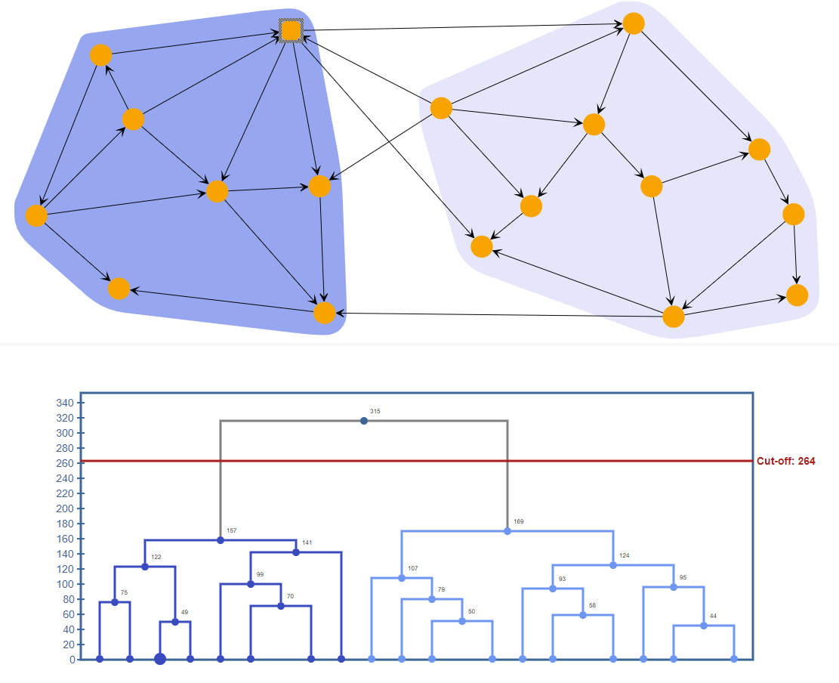
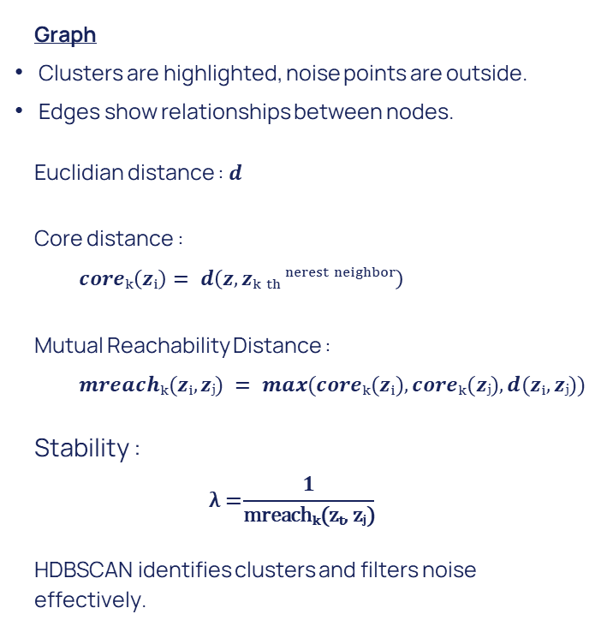
HDBSCAN
Graph
Clusters are highlighted, noise points are outside.
Edges show relationships between nodes.
Euclidian distance : $d$
Core distance :
$$coreₖ\left(zᵢ\right)= d\left(z, zₖ ₜₕ ⁿᵉʳᵉˢᵗ ⁿᵉⁱᵍʰᵇᵒʳ\right)$$
Mutual Reachability Distance :
$$mreachₖ(zᵢ, zⱼ) = max(coreₖ(zᵢ), coreₖ(zⱼ), d(zᵢ, zⱼ))$$
Stability :
$$\text{λ}\text{ =}\frac{1}{\text{mreach}\text{ₖ(}\text{z}\text{ₜ, }\text{z}\text{ⱼ)}}$$
HDBSCAN identifies clusters and filters noise
effectively.
Noise
10

Slide 11
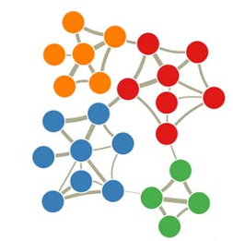
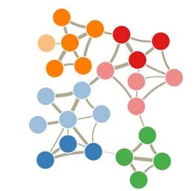
Workflow
Tracking Cluster Evolution
Objective: Understand how clusters change over time.
Key Changes Identified:
Mergers: Two or more clusters combine.
Splits: A single cluster divides into smaller ones.
New Clusters: Previously unseen clusters emerge.
Process: Compare cluster structures using the Hungarian Method.
Time-1
Splits cluster
Time-2
11

Slide 12
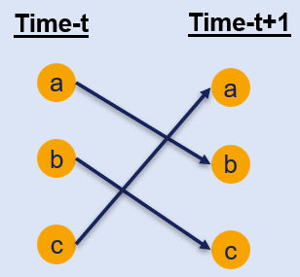
Hungarian Method
Input: Clusters from two consecutive time points
(t and t+1) identified using HDBSCAN.
Process:
Calculate a cost matrix to represent the similarity between clusters.
Use the Hungarian Method to find the best matches between clusters, minimizing mismatches.
Output:
Optimal matches between clusters.
12

Slide 13
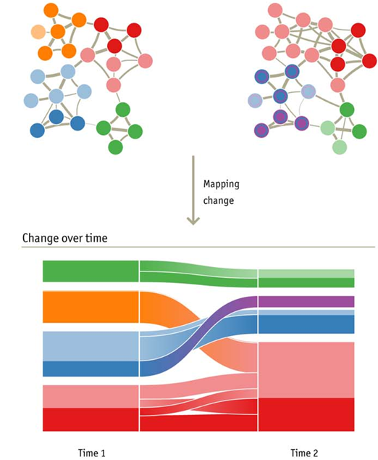
Workflow
Alluvial Diagram Visualization
Objective: Visualize structural changes in clusters over time.
Diagram Features:
Blocks: Represent clusters at specific time points.
Streams: Show transitions such as splits, merges, or stability.
Colors: Differentiate clusters visually.
13

Slide 14
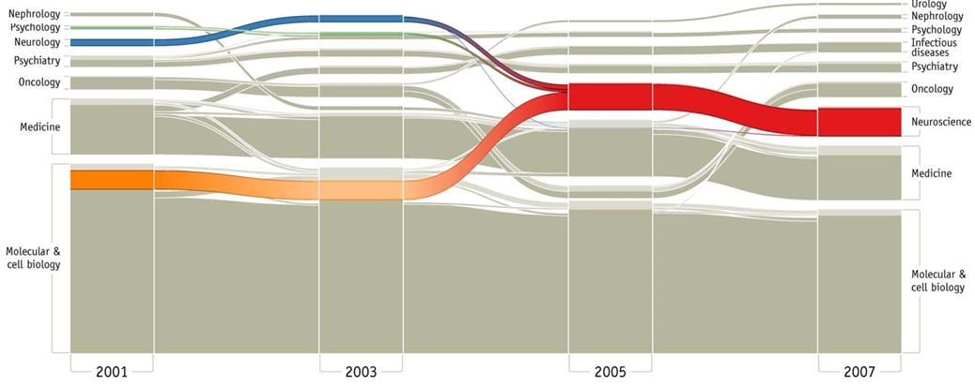
Alluvial Diagram Visualization
14

Slide 15

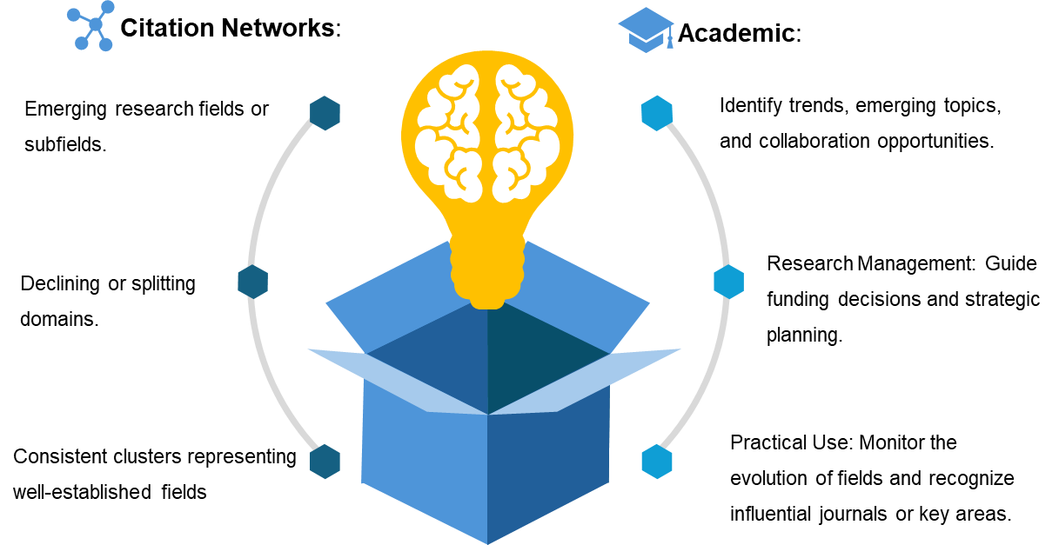
Insights and Applications
15

Slide 16
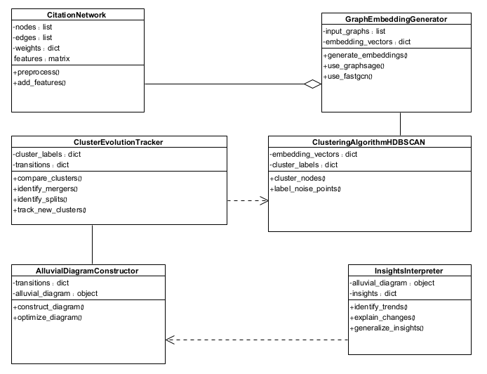
UML – Class diagram
16

Slide 17
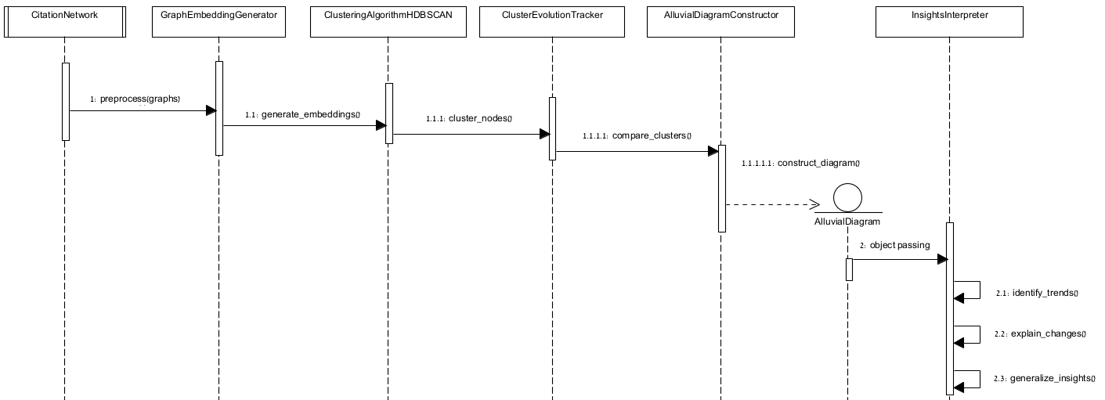
UML –Sequence Diagram
17

Slide 18
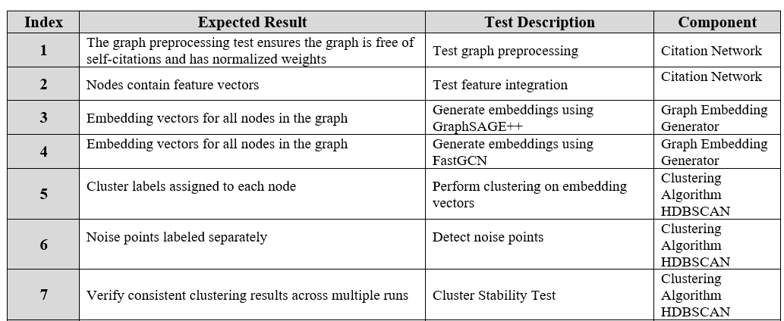
Testing Plan
18

Slide 19
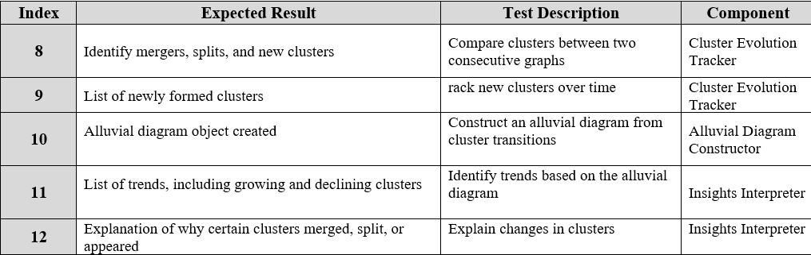
Testing Plan
19

Slide 20


Thanks!
20

